Slide 1

Scrum Agile Methodology Gideon Gendale D. Mesia CS 250 Software Development Lifecycle Professor Haruka Konishi 22 June 2025

Slide 2
Table of Contents
Agile Roles
Agile Phases
Waterfall Model
Waterfall or Agile Approach?

Slide 3

Agile Roles What each Member adds to the team

Slide 4

Product Owner
The Product Owner is the gap that fills the communication between the client and the rest of the team members.
They define the Vision of the Project which includes the client's requirements.
They manage the Product Backlog, prioritizing task from high, medium, or low.
They maximize the value of the team’s work for the client.

Slide 5

Scrum Master
The Scrum Master mentors and guides the development team throughout the agile process.
They facilitate Scrum Events such as Scrum Planning, the Sprint, Daily Scrum, and Sprint Review/Retrospective.
Works hand in hand with Product Owner to make sure project is headed towards the right direction.

Slide 6

Tester
The Tester is the quality control of the Development Team.
They act as the user for the product.
Works closely with developer to ensure product is user friendly or up to client’s standards, testing for bugs in the system.
Relays information to Product Owner to inform Client of the products success.

Slide 7

Developer
Builds the clients product to the customers requirements.
Collaborates with all members to ensure product is correct.
Adapts to changes to customer requirements
Plans estimated time for each task of the project.

Slide 8

Agile Phases
Each step of the SDLC

Slide 9
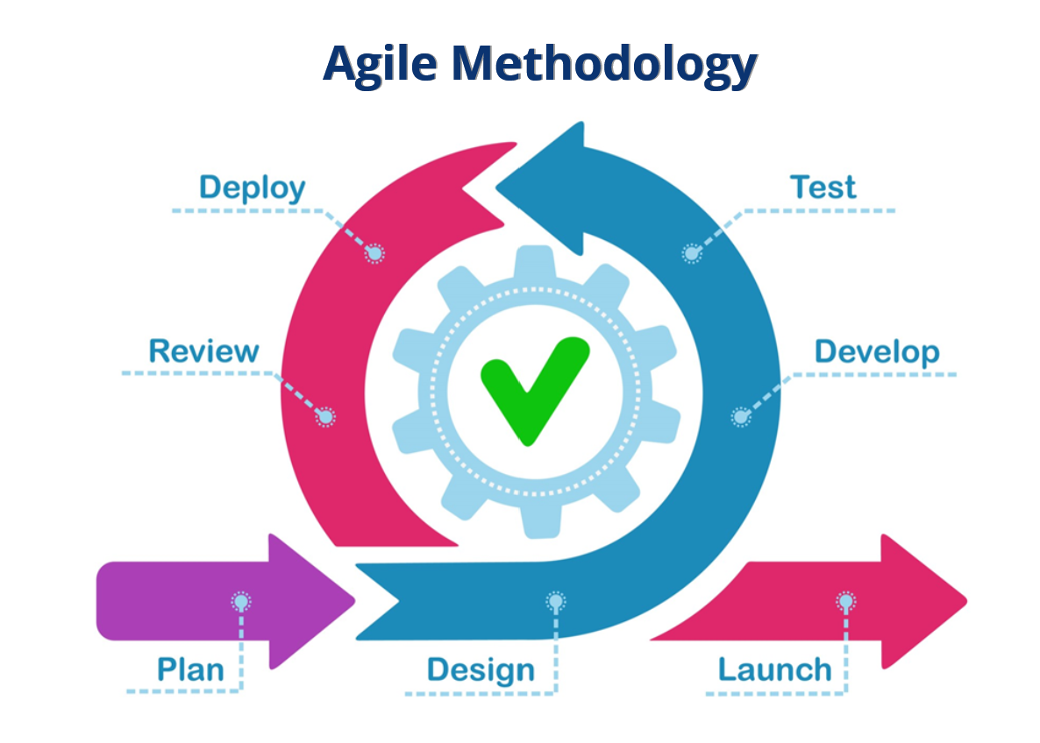
SDLC Phases
Requirements Analysis
System Design
Implementation
Testing
Deployment
Maintenance

Slide 10
Requirement Analysis
This is where the Project begins and where the Development Team or Product Owner meets with the client to figure out the requirements of the product. This will set a clear direction for all individuals working withing the project.
This is where the Scrum Master in the Scrum Agile Method would give clear directions on Scrum Meeting Requirements and expectations from each team member such as the Agile Team Charter.
The Product Owner may further talk to the client to get more information on the purpose of the product and may even ask their clients customers for input.

Slide 11
System Design
This is where the project is laid out and planned for the rest of the project's duration.
Scrum Planning is introduced, where depending on the team’s previous cooperation, may end up with Planning Poker, Story Points, or any of the other planning methods that dictate priority and time for each project. This will also include User Stories.
This is where the Product Owner will let the development team know what is required of them. The Scrum Master will enforce Product Owners request throughout the remainder of the project.

Slide 12
Implementation
This is where the Project will be devolved having the developer going off the priorities to create small completed products that can be sent up to the tester to test the product later.
Here the developer will have communication with the Product Owner to relay information about the project to the client if changes are needed to the product. Also adapts to changes within the project by the client.
This will consume the most time, so communication is key within the process to make sure the developers and the client's requirements are aligned or else the project could be a failure. Daily Scrum meetings happened in this phase.

Slide 13
Testing
The tester is the quality control the developer sends up, checking for bugs, user and client requirements, and if the product is maintainable.
The tester will indicated potential issues with the product to the developer and the Product Owner to relay to the client, or also recommendations to improve user experience.
Once Quality control is checked and meets all the requirements, can be sent up to client. If not, goes back to developer to fix necessary requirements until product is satisfactory creating a small loop where the product is continuously chekled for quality assurance.

Slide 14
Deployment
This is where the product gets sent up to the client to be used, where the client can release the product slowly or until the requirements are finished.
In the Agile method the Scrum Review where both the Development Team and the Client Talk about what they’ve completed, any concerns they have, and what can be improved on, and how the product will function with their customers. This adds another layer of communication between all members.
Potentially The Sprint Retrospective could also be done after the Sprint Review here.

Slide 15
Maintenance
This is where any potential missed bugs can be fixed and adjusted or any other issues that had missed the testing phase..
This is where I would put the Sprint Retrospective as the client is not included here. They are able to talk about what was done well and what they could potentially improve on in the next Sprint Cycle. The Retrospective improves unit cohesion through honest communication.

Slide 16

Waterfall Model
Difference from Agile

Slide 17
Waterfall Model Pros
The pros if I had used this model is that the product would have been done faster.
Client input is limited and there is little to no communication reducing time trying to figure out information and more focus on finishing the product.
Design is finalized meaning coding meaning no changes throughout the process, reducing time and keeping with timelines.
It is linear, which means there is novriation in which direction to go, reducing time again.

Slide 18
Waterfall Model Cons
No input from anyone else means product may not be up to standards.
Limited or no cross communication means limited direction and developers may veer off from client's vision.
If client is unsatisfied, then project failure would have wasted time money and effort.
Not flexible to any changes, meaning if changes were needed, timelines may change and may not reach the deadline.

Slide 19
Waterfall Model Usage
Having used the Waterfall method instead of the Agile Method would have been a disaster to both the developers and the client. When the product would have been finished, the clients would have wanted changes to a slide instead of a billboard and would now want the client's customers to focus on wellness. The product would have not met the standards, and the delay would have caused the client to potentially loose money. Also without the cross communication, the direction of the project may have veered off or the client may not have not know what to do.

Slide 20

Waterfall or Agile Approach?
Choosing the right model

Slide 21
Waterfall vs Agile
Waterfall
Requirements are set in stone
Design is often finalized in beginning
Product tested after completion
Client sees product when finished
Limited Communication
Limited Client Involvement
Agile
Requirements can shift
Design can change throughout
Product tested throughout
Client sees changes throughout
Cross Functional Communication
Constant Client Input

Slide 22
When to use each model
The waterfall method is best used for big projects with a hard timeline and concrete design to the final product. The additional communication takes time and unless the client needs the product to adapt, there is no requirement for the client. It falls short however when changes are required as it is expensive to go back and fix or adjust the product.
The agile method is best used for established development teams and clients with specific requirements. The additional communication from client and team allows for product to be the best as could possibly be. With this the team can be much more flexible to client's changes. It falls short when you need an established team or a strong mentor to guide person to the correct direction.
Both methods have their place, but Agile is becoming the go to as it has more flexibility in an industry where constant changes have to be made.

Slide 23
References
Cobb, C. G. (2015). The Project Manager’s Guide to Mastering Agile. https://openlibrary.org/books/OL29270641M/Project_Manager's_Guide_to_Mastering_Agile
Rehkopf, M. (2025, April 24). User stories with examples and a template. Atlassian. https://www.atlassian.com/agile/project-management/user-stories
Sutherland, J. (2014). Scrum: the art of doing twice the work in half the time. https://library.pqm.co.id/index.php?p=show_detail&id=5257&keywords=
Sabharwal, N., Rathore, R., & Agrawal, U. (2021). Introduction to agile methods. In Apress eBooks(pp. 69–111). https://doi.org/10.1007/978-1-4842-7505-4_5

Slide 24

Thank You
Gideon Gendale D. Mesia CS 250 Software Development Lifecycle Professor Haruka Konishi 22 June 2025

